Slide 1



Prompt Engineering
Chapter 6

Slide 2


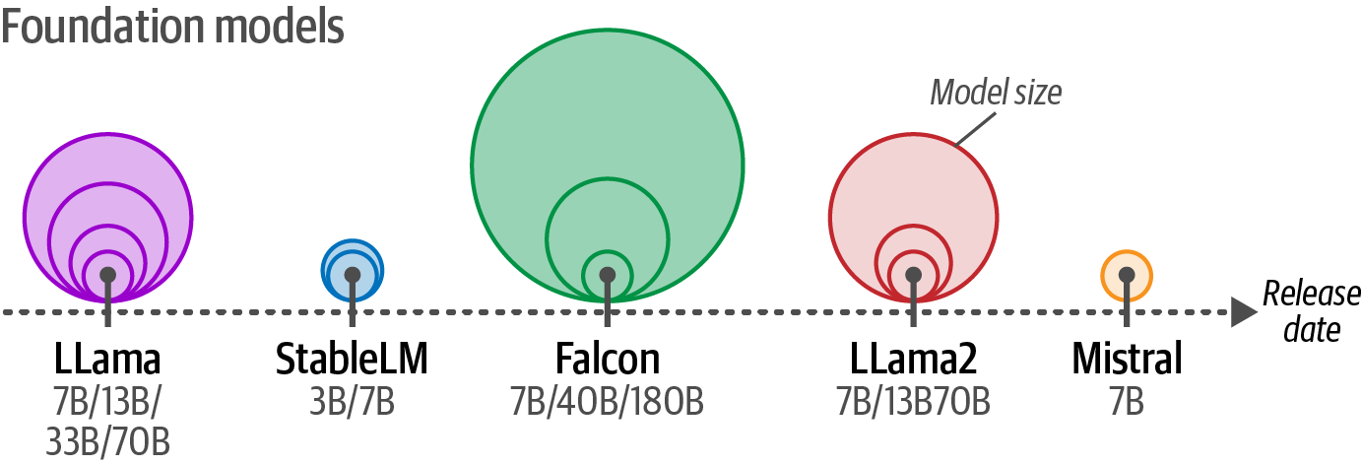
Impactful foundation models
Foundation models are often released in several different sizes.

Slide 3
Controlling Model Output
The model chooses the next token to generate based on their likelihood scores.
Notes:
Other than prompt engineering, we can control the kind of output we want by adjusting the model parameters. In our previous example, you might have noticed
that we used several parameters in the pipe function, including temperature and top_p.
These parameters control the randomness of the output. A part of what makes LLMs exciting technology is that it can generate different responses for the exact same
prompt. Each time an LLM needs to generate a token, it assigns a likelihood number to each possible token.
When we loaded our model, we purposefully set do_sample=False to make sure the output is somewhat consistent.

Slide 4
Temperature
A higher temperature increases the likelihood that less probable tokens are generated and vice versa.
Notes:
The temperature controls the randomness or creativity of the text generated. It defines how likely it is to choose tokens that are less probable. The underlying idea is that a temperature of 0 generates the same response every time because it always chooses the most likely word.

Slide 5
top_p
A higher top_p increases the number of tokens that can be selected to generate and vice versa.
Notes:
top_p, also known as nucleus sampling, is a sampling technique that controls which subset of tokens (the nucleus) the LLM can consider. It will consider tokens until it reaches their cumulative probability.

Slide 6
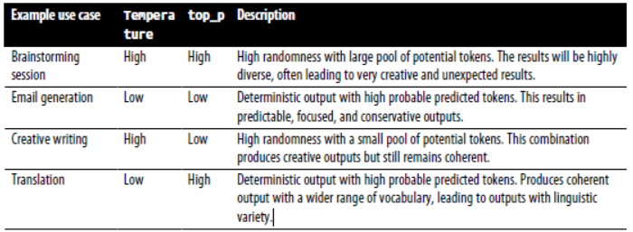
Temperatura and Top-p
Use case examples when selecting values for temperature and top_p.

Slide 7
Prompt
Two components of a basic instruction prompt: the instruction itself and the data it refers to.

Slide 8
Prompt 2
Extending the prompt with an output indicator that allows for a specific output.

Slide 9
Instruction-Based Prompting
Use cases for instruction-based prompting.
Notes:
Although prompting comes in many flavors, from discussing philosophy with the LLM to role-playing with your favorite superhero, prompting is often used to have the LLM answer a specific question or resolve a certain task. This is referred to as instruction-based prompting.

Slide 10
Exemples:
Prompt examples of common use cases. Notice how within a use case, the
structure and location of the instruction can be changed.

Slide 11
prompting techniques:
Specificity
Hallucination
Order
Notes:
Specificity Accurately describe what you want to achieve. Instead of asking the LLM to “Write a description for a product” ask it to “Write a description for a product in less than two sentences and use a formal tone.”
Hallucination. LLMs may generate incorrect information confidently, which is referred to as hallucination. To reduce its impact, we can ask the LLM to only generate an answer if it knows the answer. If it does not know the answer, it can respond with “I don’t know.”
Order Either begin or end your prompt with the instruction. Especially with long prompts, information in the middle is often forgotten.1 LLMs tend to focus on information either at the beginning of a prompt (primacy effect) or the end of a prompt (recency effect).

Slide 12
Advanced components
Persona
Instruction
Context
Format
Audience
Tone
Data
Notes:
Persona
Describe what role the LLM should take on. For example, use “You are an expert in astrophysics” if you want to ask a question about astrophysics.
Instruction
The task itself. Make sure this is as specific as possible. We do not want to leave much room for interpretation.
Context
Additional information describing the context of the problem or task. It answers questions like “What is the reason for the instruction?”
Format
The format the LLM should use to output the generated text. Without it, the LLM will come up with a format itself, which is troublesome in automated systems.
Audience
The target of the generated text. This also describes the level of the generated output. For education purposes, it is often helpful to use ELI5 (“Explain it like I’m 5”).
Tone
The tone of voice the LLM should use in the generated text. If you are writing a formal email to your boss, you might not want to use an informal tone of voice.
Data
The main data related to the task itself.

Slide 13
In-Context Learning: Providing Examples
An example of a complex prompt with many components.
Notes:
An example of a complex prompt with many components.

Slide 14
Chain Prompting
Using a description of a product’s features, chain prompts to create a
suitable name, slogan, and sales pitch.
Notes:
To illustrate, let us say we want to use an LLM to create a product name, slogan, and sales pitch for us based on a number of product features. Although we can ask the LLM to do this in one go, we can instead break up the problem into pieces. As a result, and as illustrated in Figure 6-14, we get a sequential pipeline that first creates the product name, uses that with the product features as input to create the slogan, and finally, uses the features, product name, and slogan to create the sales pitch.

Slide 15
Chain-of-thought
Chain-of-thought prompting uses reasoning examples to persuade the generative model to use reasoning in its answer.

Slide 16
Chain Prompting
Chain-of-thought prompting without using examples. Instead, it uses the
phrase “Let’s think step-by-step” to prime reasoning in its answer.
Notes:
To illustrate, let us say we want to use an LLM to create a product name, slogan, and sales pitch for us based on a number of product features. Although we can ask the LLM to do this in one go, we can instead break up the problem into pieces. As a result, and as illustrated in Figure 6-14, we get a sequential pipeline that first creates the product name, uses that with the product features as input to create the slogan, and finally, uses the features, product name, and slogan to create the sales pitch.

Slide 17
Self-Consistency
By sampling from multiple reasoning paths, we can use majority voting to
extract the most likely answer.
Notes:
To counteract this degree of randomness and improve the performance of generative models, self-consistency was introduced. This method asks the generative model the
same prompt multiple times and takes the majority result as the final answer.9 During this process, each answer can be affected by different temperature and top_p values
to increase the diversity of sampling.

Slide 18
Tree-of-Thought:
By leveraging a tree-based structure, generative models can generate intermediate thoughts to be rated. The most promising thoughts are kept and the lowest are pruned.
Notes:
The method works as follows. When faced with a problem that requires multiple reasoning steps, it often helps to break it down into pieces. At each step, the generative model is prompted to explore different Reasoning with solutions to the problem at hand. It then votes for the best solution and continues to the next step.

Slide 19
Output Verification
Structured output
Valid output
Ethics
Accuracy
Grammar
Fine-tuning
Notes:
Structured output
By default, most generative models create free-form text without adhering to
specific structures other than those defined by natural language. Some use cases
require their output to be structured in certain formats, like JSON.
Valid output
Even if we allow the model to generate structured output, it still has the capability
to freely generate its content. For instance, when a model is asked to output
either one of two choices, it should not come up with a third.
Ethics
Some open source generative models have no guardrails and will generate outputs
that do not consider safety or ethical considerations. For instance, use
cases might require the output to be free of profanity, personally identifiable
information (PII), bias, cultural stereotypes, etc.
Accuracy
Many use cases require the output to adhere to certain standards or performance.
The aim is to double-check whether the generated information is factually accurate,
coherent, or free from hallucination.
Controlling the output of a generative model, as we explored with parameters like
top_p and temperature, is not an easy feat. These models require help to generate
consistent output conforming to certain guidelines.
Generally, there are three ways of controlling the output of a generative model:
Examples
Provide a number of examples of the expected output.
Grammar
Control the token selection process.
Fine-tuning
Tune a model on data that contains the expected output.

Slide 20










TYPES OF AI
NARROW AI
GENERAL AI
SUPER AI
Narrow AI is designed to perform a specific task
General AI can perform any intellectual task that a human can
Super AI is hypothetical and would surpass human intelligence

Slide 21





HISTORY OF AI
The Dartmouth Conference, where the term "artificial intelligence" was first coined and AI was established as a field of research.
1956
The first AI system that could understand and respond to natural language was created by Terry Winograd, which marked a major step forward in natural language processing.
1974
IBM's Deep Blue defeated the world chess champion Garry Kasparov, demonstrating that machines could surpass human intelligence in specific domains.
1997
The emergence of deep learning led to breakthroughs in computer vision, speech recognition, and natural language processing.
2012

Slide 22



IN FINANCE
75%
12,000
50%
people said that AI has improved their decision-making process.
Morgan Chase used AI to analyze 12,000 commercial loan agreements in seconds
The use of AI in fraud detection has led to a 50% reduction in false positives

Slide 23








IN MANUFACTURING
Item 2
Item 3
12
10
8
6
4
2
0
2015
2016
2017
2018
2019
2020
2021

Slide 24








IN TRANSPORTATION
REDUCE 20% FUEL CONSUMPTION
REDUCE 30% MAINTENANCE COSTS
Self-driving trucks powered by AI have been shown to reduce fuel consumption by up to 20%, saving companies thousands of dollars per year.
AI-powered predictive maintenance can reduce maintenance costs by up to 30%, and increase vehicle reliability and uptime.

Slide 25






03
SOCIAL IMPLICATIONS
Explores the broader impact of AI beyond specific industries or applications. Considers ethical and societal implications such as job displacement, bias, privacy concerns, and potential impacts on democracy and human rights. Encourages a critical and thoughtful approach to AI development and deployment, taking into account the potential risks and benefits to individuals and society as a whole.

Slide 26




AI AND JOBS
JOBS AT HIGH RISK
JOBS AT SIGNIFICANT RISK
14%
32%

Slide 27



AI ETHICS
81%
People believe that companies should prioritize ethical considerations
63%
Were concerned about the ethical implications of the AI system

Slide 28




AI AND PRIVACY
A survey by Pew Research Center found that 64% of Americans are concerned about the way that companies are using their data, and 81% feel that they have little or no control over the data that companies collect about them.
20%
55%
The EU's GDPR includes provisions for ensuring that individuals have the right to access and control their personal data, including data that is processed using AI systems.

Slide 29



AI AND SOCIETY
Discusses the broader societal implications of AI, including its impact on job displacement, inequality, and social norms. This section aims to provide a comprehensive understanding of the ways in which AI is shaping our society and the challenges that need to be addressed.
04

Slide 30


THE RISE OF POWERFUL AI WILL BE EITHER THE BEST OR THE WORST THING EVER TO HAPPEN TO HUMANITY. WE DO NOT YET KNOW WHICH.
STEPHEN HAWKING

Slide 31








THANK YOU FOR
CHOOSING EATEMP
We offer free and high-quality slides templates for your presentations. We appreciate you choosing us and hope our templates have been helpful.
As a new website, we rely on your support to grow, so please help us by sharing our site with your friends and colleagues.
eatemp._
@eatemp
eatempofficial
@eatemp.official

